Slide 1
Deep Learning

Slide 2
Contents
Deep learning introduction
The Perceptron and ANN
Convolutional Neural Networks
Deep Learning Architectures
Deep Learning Frameworks
Deep learning applications and trends
Personal recommendations

Slide 3
1.
DEEP LEARNING
A brief introduction

Slide 4
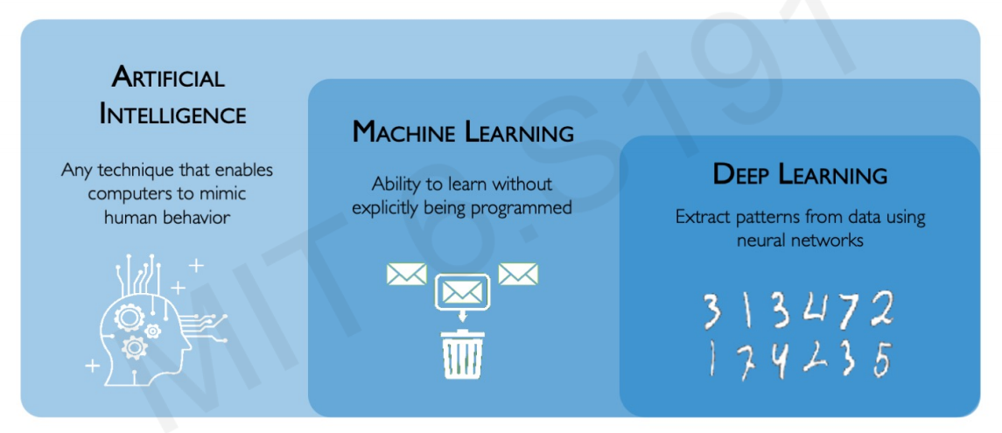
What is Deep Learning?

Slide 5
Why Deep Learning?
Drawbacks of hand engineered features (Traditional ML)
Time-consuming
Brittle and not robust (can over fit)
Computationally intensive (high dimensionality)
Domain expert required to reduce the complexity of the data and make patterns more visible to learning algorithms to work.
Not end-to-end (problem is solved in various parts)

Slide 6
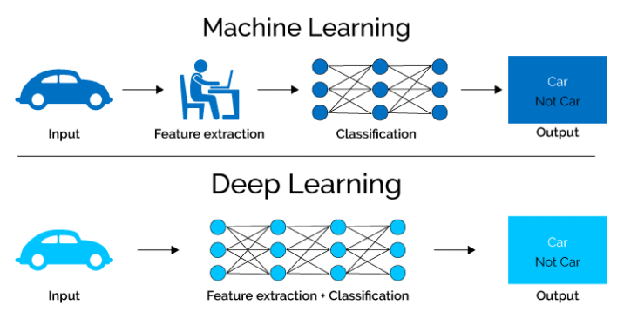
Why Deep Learning?

Slide 7
Why Deep Learning?
Main advantages
Learn high-level features automatically from data
Eliminates the need of hard core feature extraction by a domain expert
End-to-end solution
Machine learning algorithms include SVM, random forests, decision trees, regression, kNN etc.
Deep learning is based on neural networks

Slide 8
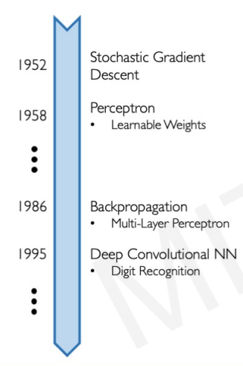
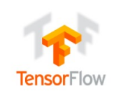
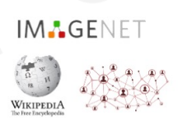
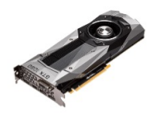
Why Now?
Neural Networks date back decades, so why the resurgence?
Big Data
Hardware
Software

Slide 9
2.
THE PERCEPTRON
The structural building blovk of deep learning

Slide 10
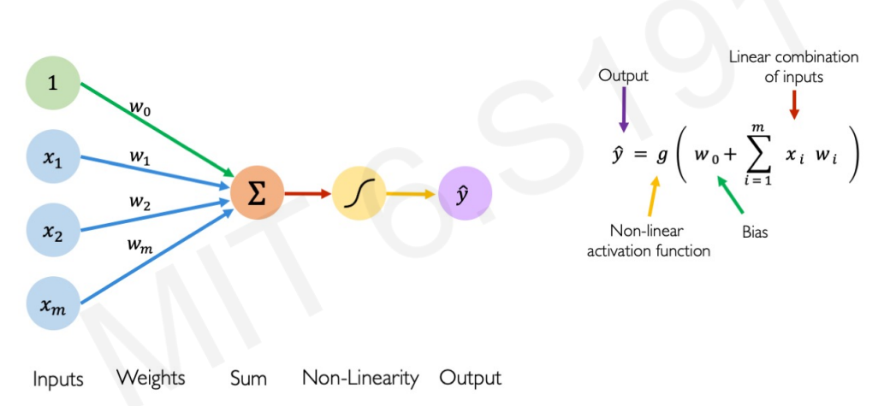
The Perceptron: Forward Propagation

Slide 11
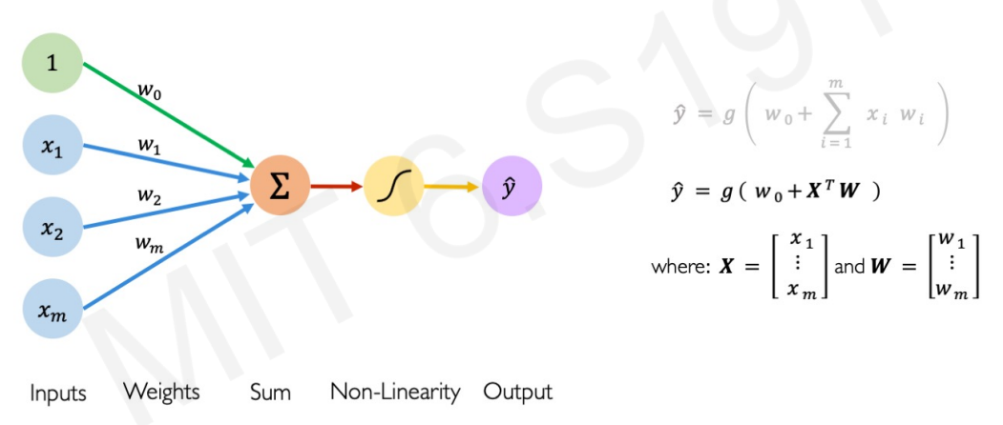
The Perceptron: Forward Propagation

Slide 12
3.
NEURAL NETWORKS
Building Neural Networks with perceptron

Slide 13
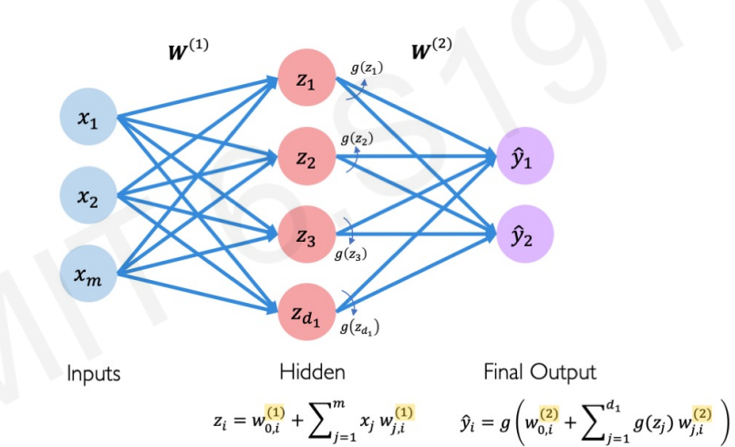
Single Layer Neural Network

Slide 14
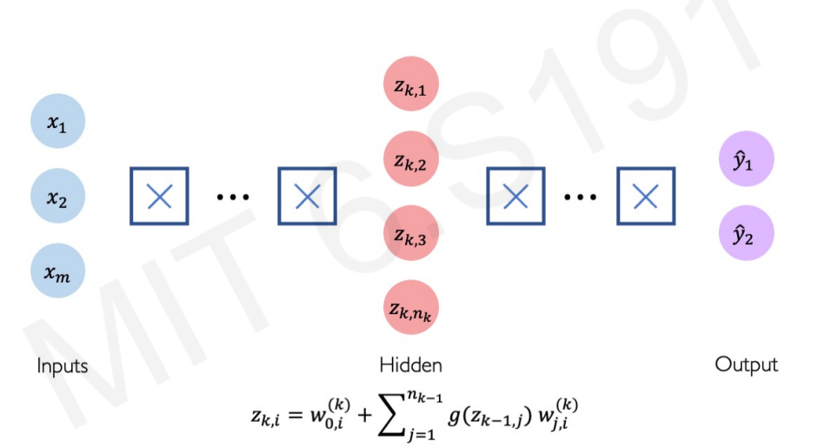
Deep Neural Network

Slide 15
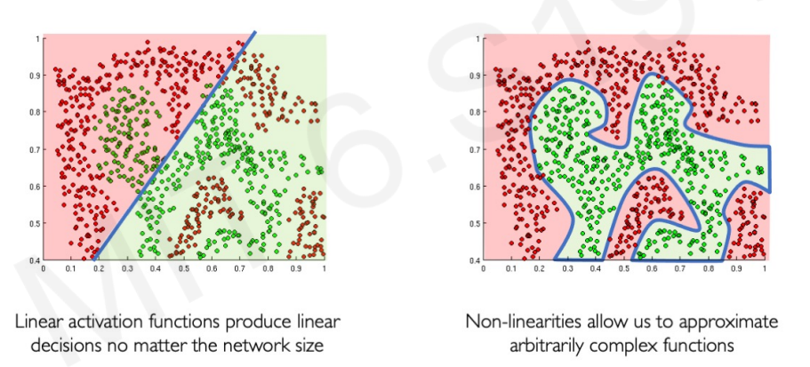
Activation functions
The purpose of activation functions is to introduce nonlinearities into the network
Non-linear models have better discriminative abilities and can fit complex data

Slide 16
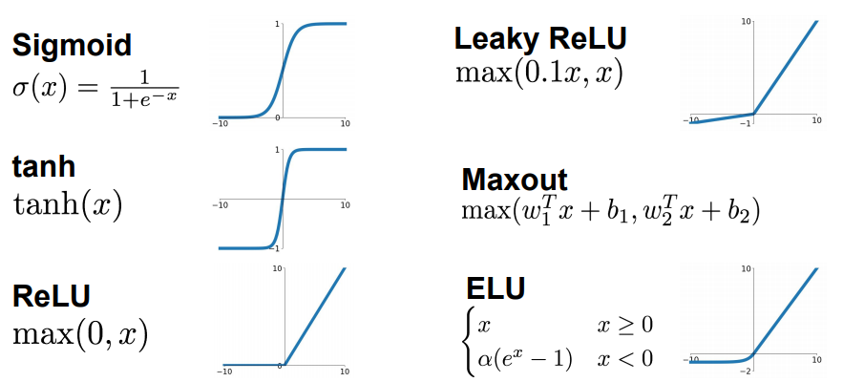
Activation functions

Slide 17
4.
CONVOLUTIONAL NEURAL NETWORKS

Slide 18
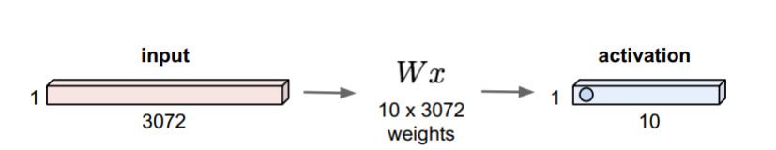
Fully Connected Layer
32 * 32 * 3 image => stretch to 3072 * 1
Limitations
The number of trainable parameters increases drastically with an increase in the size of the image.
ANN loses the spatial features of an image. Spatial features refer to the arrangement of the pixels in an image.

Slide 19
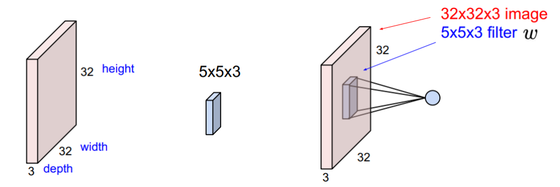
Convolutional Layer
32 * 32 * 3 image => preserve spatial structure
Filter is convolved with the image i.e. slide over image spatially, computing dot products.

Slide 20
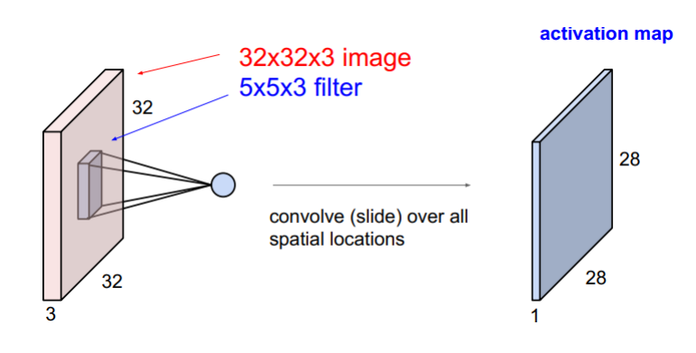
Convolutional Layer

Slide 21

Convolutional Layer

Slide 22
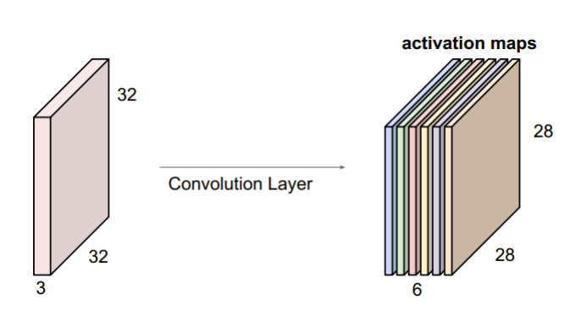
Convolutional Layer

Slide 23
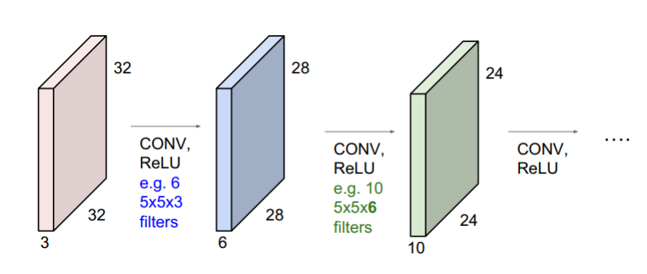
ConvNet
ConvNet is a sequence of Convolution Layers, interspersed with activation functions

Slide 24
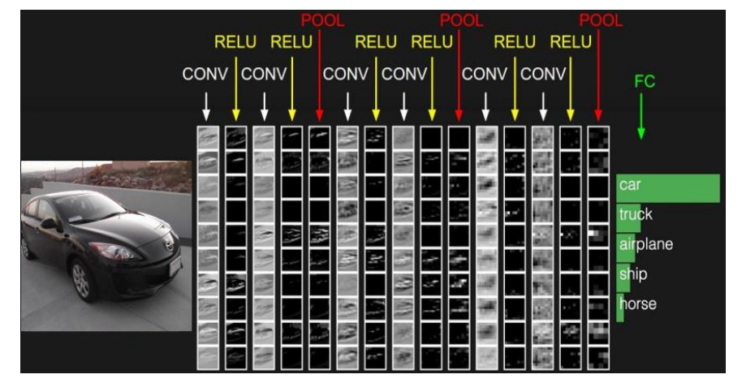
ConvNet

Slide 25
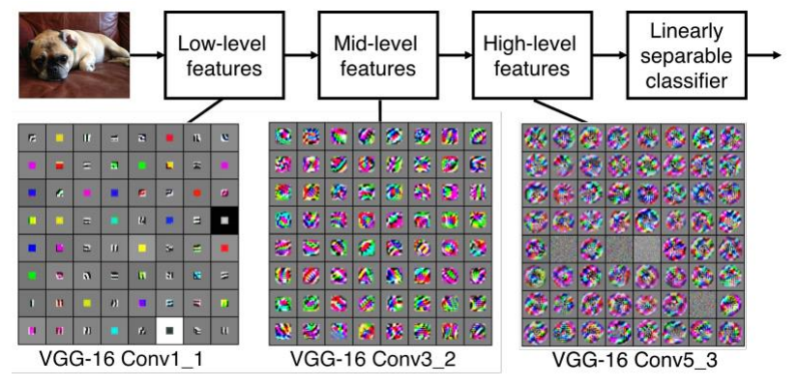
ConvNet

Slide 26
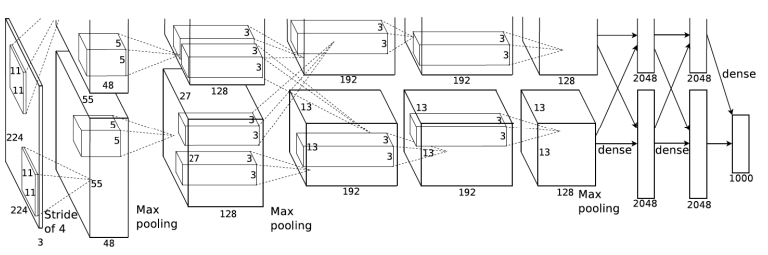
Architectures
In application, we combine conv layers and fully-connected layers
Some common architectures include AlexNet, VGG, Inception, ResNet and so on.
AlexNet (Krizhevsky et al., 2012 )

Slide 27
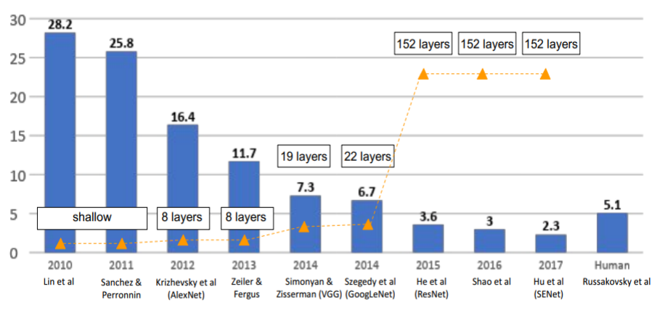
ILSVRC Winners
ImageNet Large Scale Visual Recognition Challenge (ILSVRC) winners

Slide 28
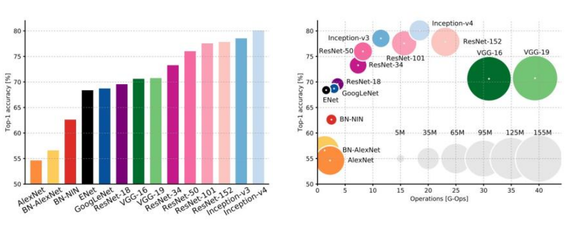
Comparison

Slide 29
Deep Learning Networks
Convolutional Neural Networks (CNNs)
Long Short Term Memory Networks (LSTMs)
Recurrent Neural Networks (RNNs)
Generative Adversarial Networks (GANs)
Radial Basis Function Networks (RBFNs)
Self Organizing Maps (SOMs)
Deep Belief Networks (DBNs)
Restricted Boltzmann Machines( RBMs)
Autoencoders
Graph Neural Networks (GNNs)

Slide 30
5.
Deep Learning Frameworks

Slide 31


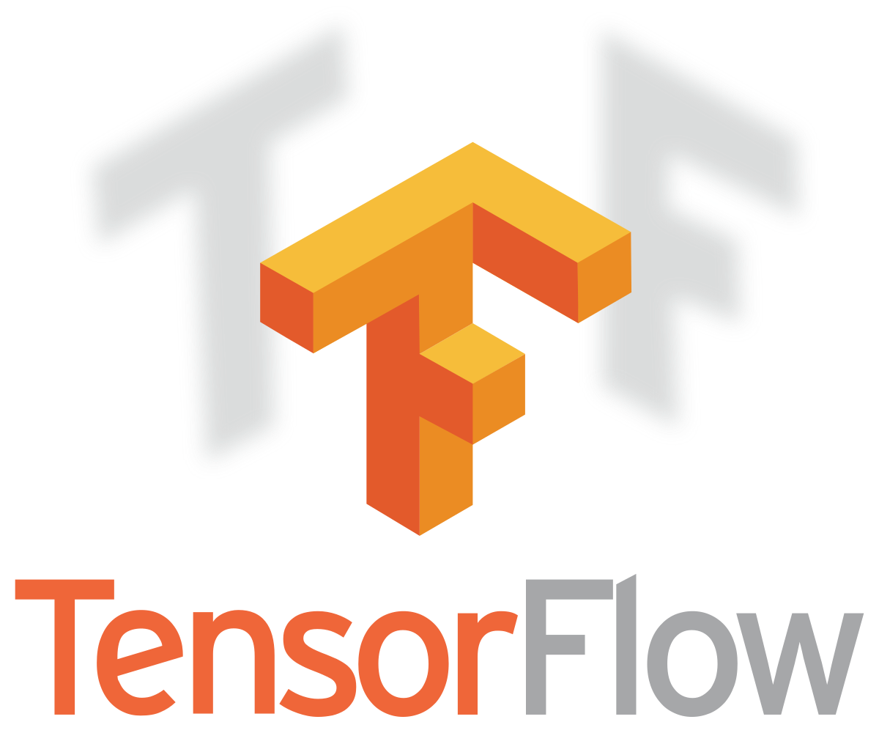

Frameworks
Common frameworks include PyTorch, Tensorflow, Keras, MCNet, Caffe, Matlab and so on.

Slide 32
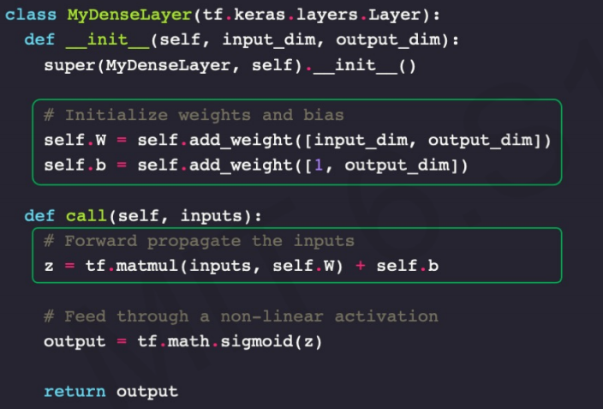
Dense Layer from Scratch

Slide 33
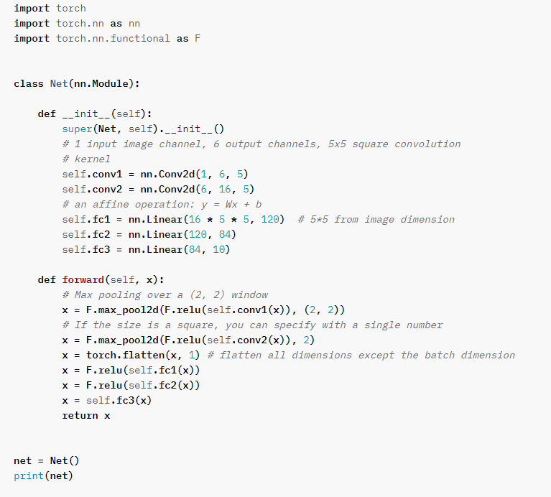
Pytorch example

Slide 34
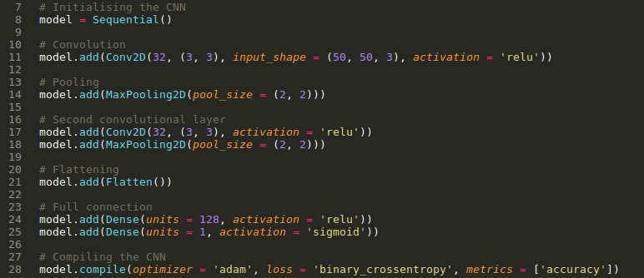
Keras example

Slide 35
6.
Applications

Slide 36
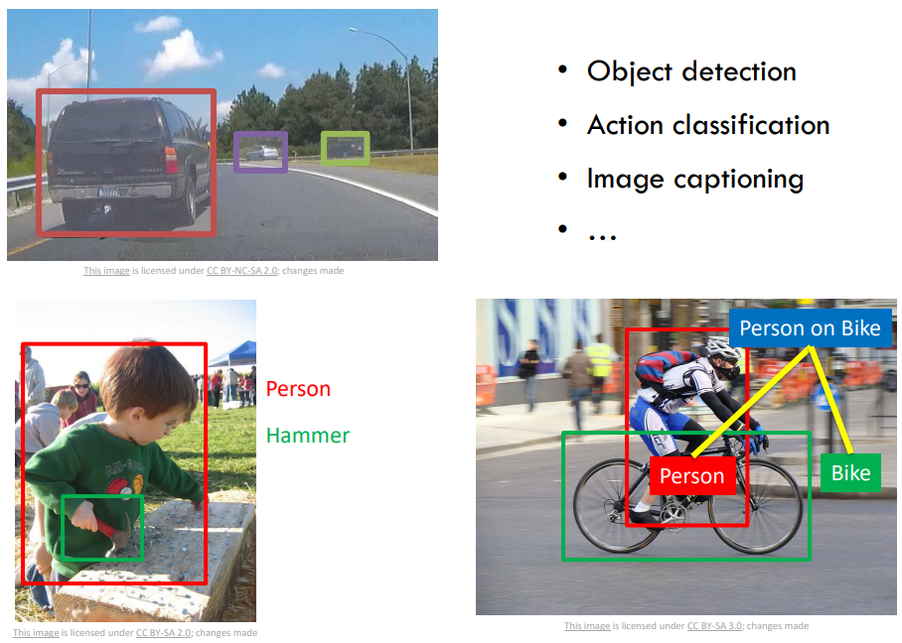
Applications

Slide 37
Applications
Classification, segmentation, detection, NLP, self-driving cars, virtual assistants, healthcare, adding sound to silent movies, machine translation, pixel restoration, image generation, deep dreaming and so on.

Slide 38
7.
Some recommendations

Slide 39
Learning
Courses
Stanford cs231n, Andrew Ng, Coursera, MIT courses
How NN actually learn and work
Cost functions, gradient descent, backpropagation, preprocessing and so on.
Youtube channels
One of the best way to learn implementations
Setndex, Deep Lizard, freecodecamp, 3Blue1Brown and many more
Official PyTorch/Tensorflow guides, documentations and implementation examples
Get familiar with python
Most of the research is carried out with python

Slide 40
Advanced
Papers
Start with basic CNN architecture papers
More recent trends and papers
Github and stack overflow
The most useful sources
Look into implementations
Implement with your own data and problem
You can work with anything that interests you, there are many applications
Images, text, voice, 3D data, point clouds and so on.
Build your own projects

Slide 41
Thanks!
My git: https://github.com/rajahaseeb147

